Slide 1


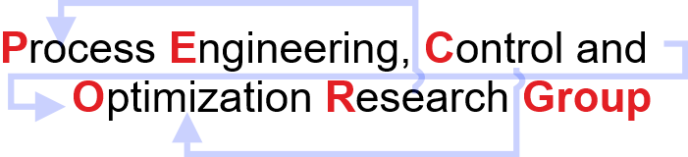
Model Predictive Control on an Arduino Device
10th Asian Symposium on Process Systems Engineering
Authors:
Subhi Gupta and Hari S. Ganesh
Discipline of Chemical Engineering,
Indian Institute of Technology Gandhinagar,
Palaj, Gujarat – 382055
India

Slide 2

Content
Introduction to Temperature Control Lab (TCLab)
System Modeling and Identification
Data Driven State Space Equations
Model Predictive Control
Parametric programming

Slide 3
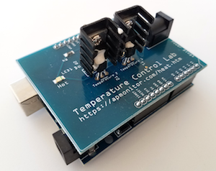
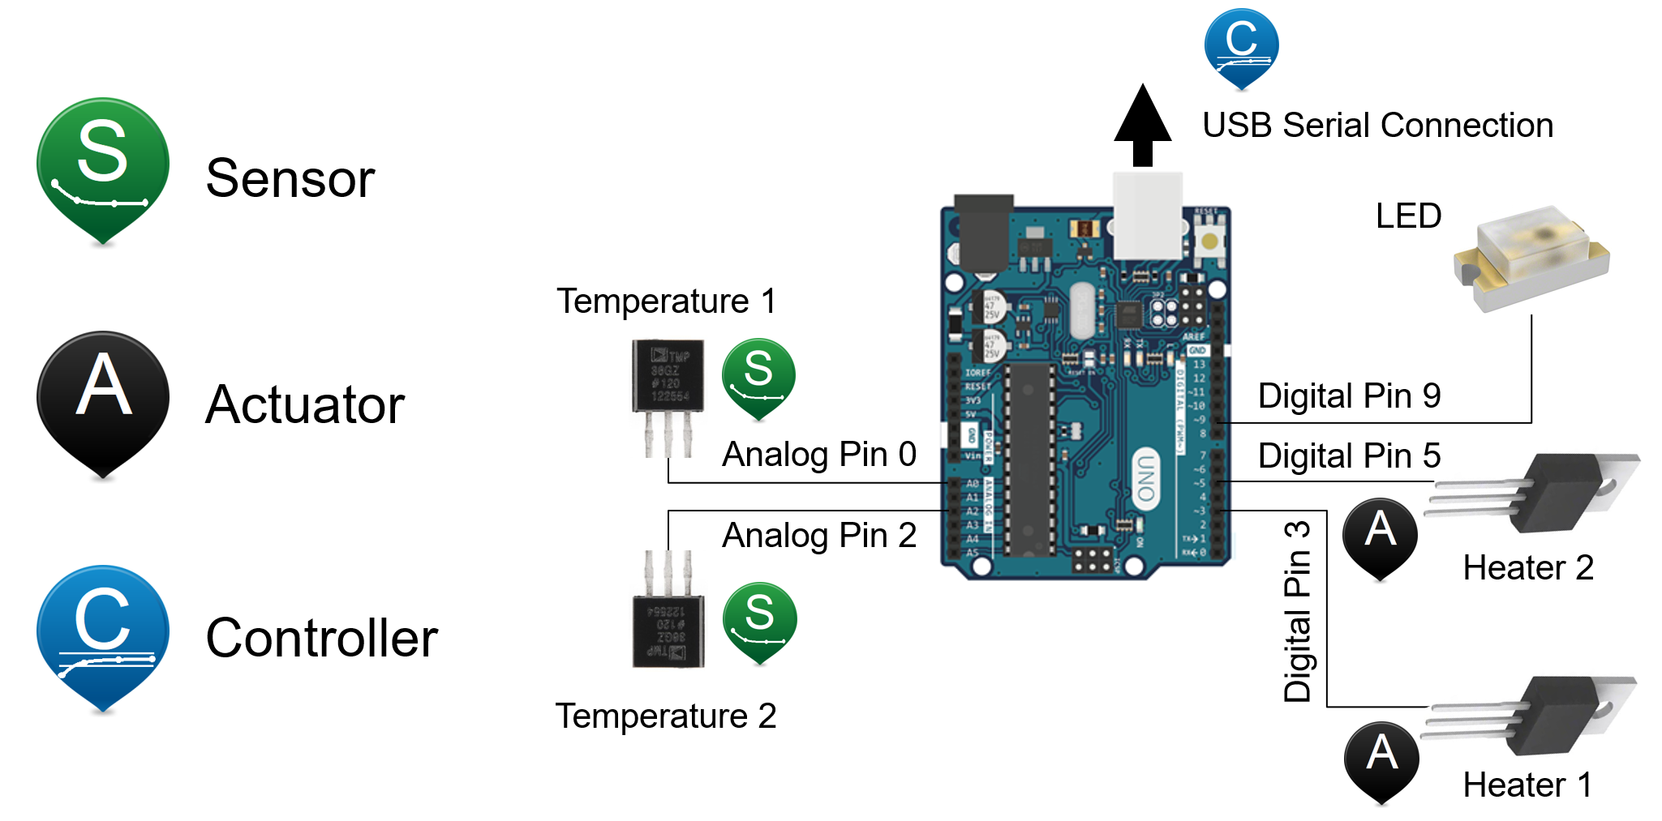
Temperature Control Lab (TCLab)
Introduction
An application of feedback control with an Arduino, an LED, two heaters, and two temperature sensors.
A MIMO device for understanding the principles of modeling, estimation, and control.
Heaters
Epoxy
Temperature Sensors
Temperature sensors and heater transistors with connections to an Arduino Leonardo.
Image Source Link: http://apmonitor.com/pdc/index.php/Main/ArduinoTemperatureControl

Slide 4
Temperature Control Lab (TCLab)
Working Principle
Implementation of control algorithm
Data Acquisition (conversion of analog signal to a digital signal to be understood by software)
PC
MATLAB/SIMULINK
Microcontroller board for hardware and software communication.
ARDUINO UNO
Analog output control
Analog
Signal
PWM
(0-100%)
POWER SUPPLY DC
HEATER
TIP41C
TEMPERATURE SENSOR (LM35)
Reference: Application of different control algorithms on a ‘home-made’ temperature control lab kit.
Reference: https://apmonitor.com/pdc/index.php/Main/TCLabSensor
Reference: The basics of Arduino: Reading Voltage- Device Plus
.
.

Slide 5
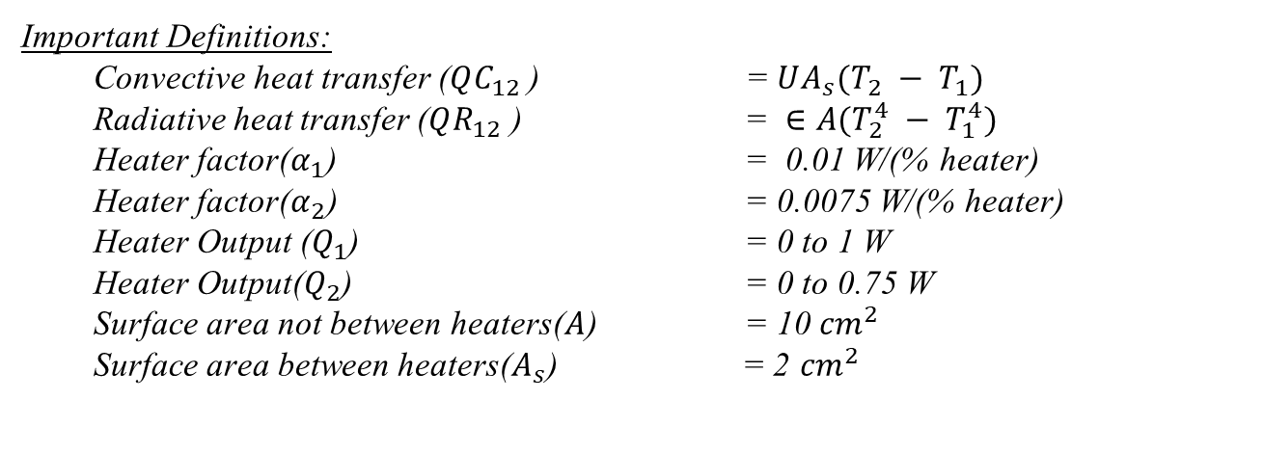
System Modeling and Identification
Dual Heater Modeling of TCLab (MIMO System)
Two energy balance equations that describe the dynamic temperature response
Reference link: apmonitor.com/do (John D. Hedengren)

Slide 6
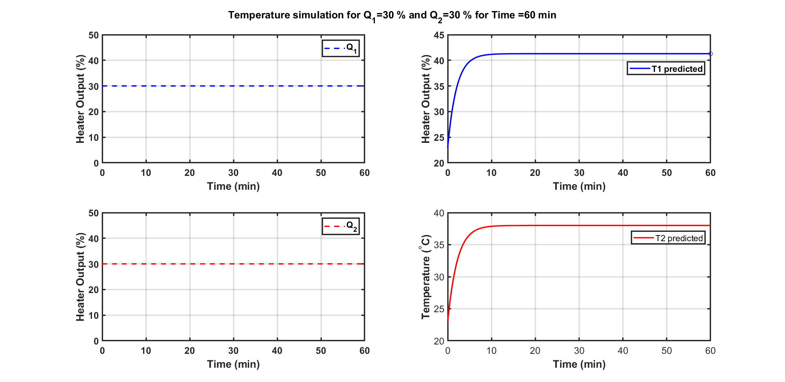
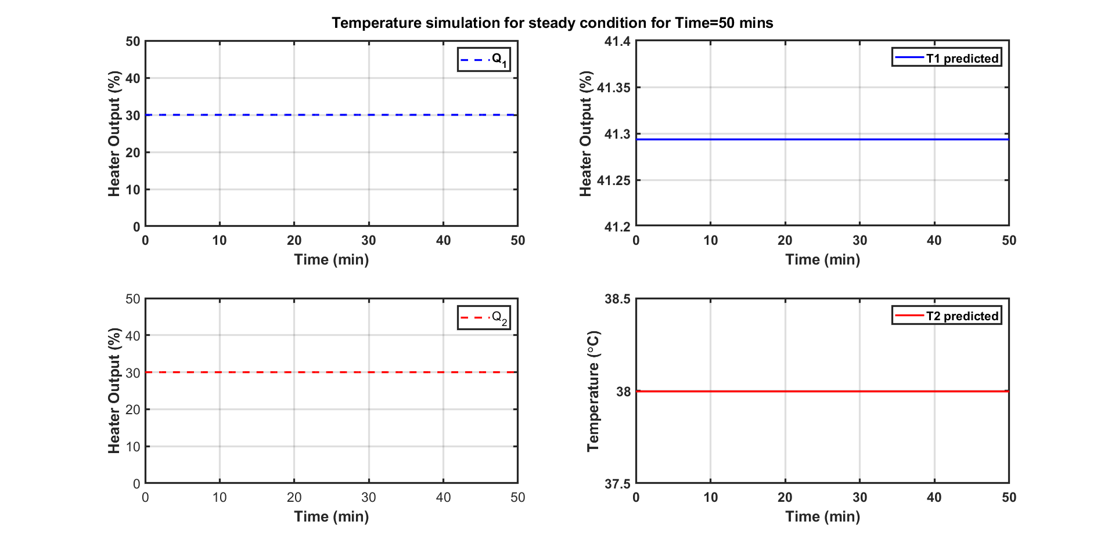
Data Driven State Space Equations
Step Response Analysis
Steady-state achieved for Q1=30 and Q2=30
Steady-state achieved for Q1=30 and Q2=30

Slide 7
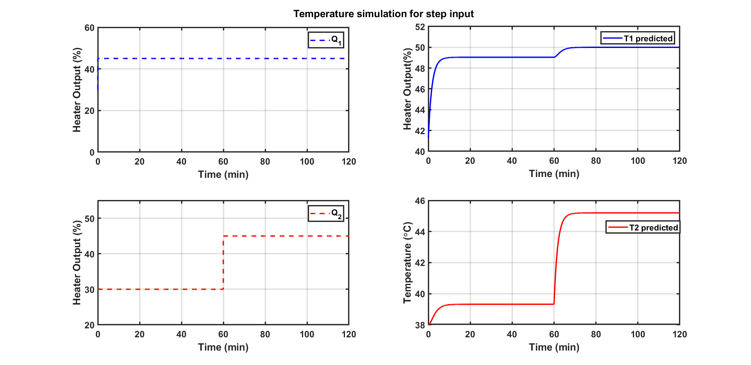
Data Driven State Space Equations
Step Response Analysis
Temperature simulation for step changes in Q1 and Q2
The above step response was used to develop data-driven state-space equations using the System Identification Toolbox.

Slide 8


Data-Driven State Space Equations
State space equations were obtained from
MATLAB System Identification Toolbox
The data obtained from the Step Response Analysis method represented a relationship between input/output.
The data is fed to MATLAB System Identification Toolbox and the differential equations representing the physical system were linearised.
The resulting pseudo states equations obtained in matrix form were used as linear constraints in MPC formulation.

Slide 9

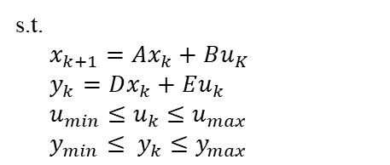
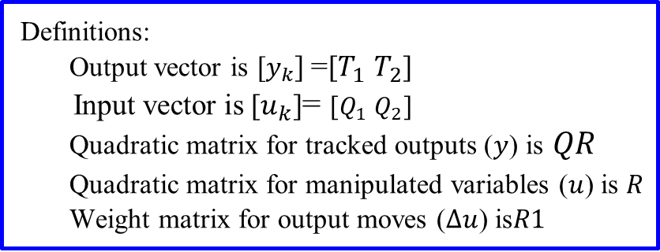
Model Predictive Control (MPC)
Formulation
State space equations
MPC formulation is first reformulated into quadratic form using ss2qp_yalmip.
At each sampling instant the quadratic problem is solved using cplexqp solver.
quadprog can also be used but cplexqp gives more stable results.

Slide 10
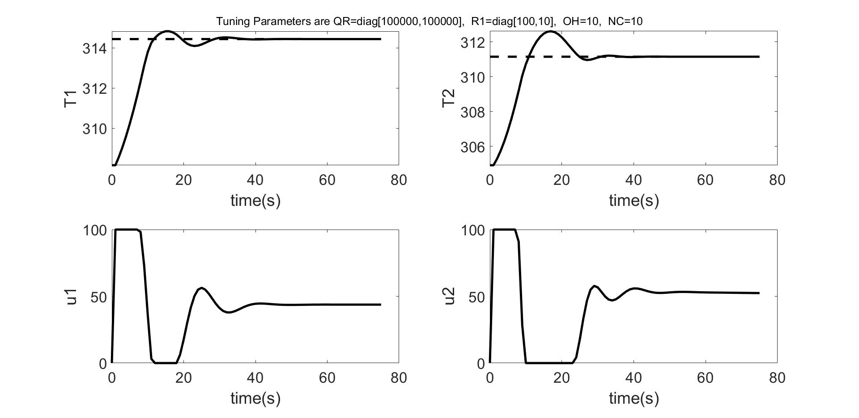
Closed-loop Simulation results.
Demonstration of Online MPC Control Calculations
Best Case of Tuning Parameters
Online MPC is computationally complex. There is low throughput
and high memory usage.
Next Task
Explicit MPC: MPC formulation was solved multi-parametrically (mp-MPC).

Slide 11


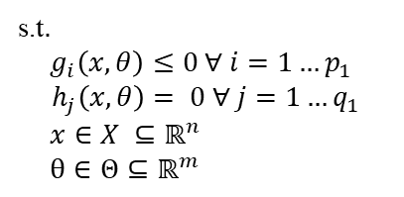
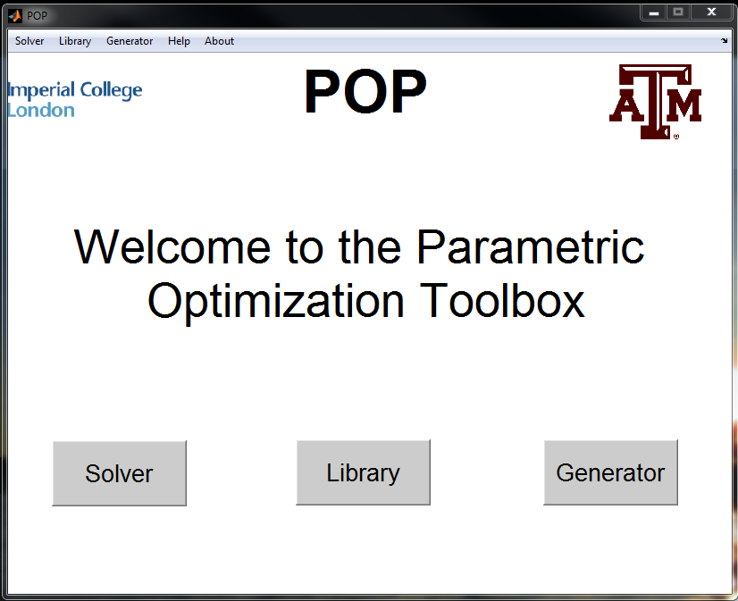
Parametric Programming
An Effective Solution Strategy
Takes into account varying parameters (𝜃).
Approach is to obtain the optimal solution (𝒙) as an explicit function of the parameters.
General parametric nonlinear programming problem
Reference: Faísca NP, Dua V, Pistikopoulos EN. 2007 Feb 9;1:1-23.
Image Source: https://parametric.tamu.edu/POP/

Slide 12
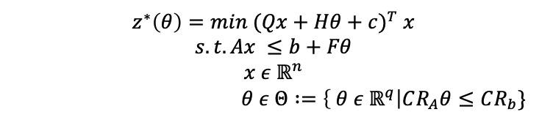
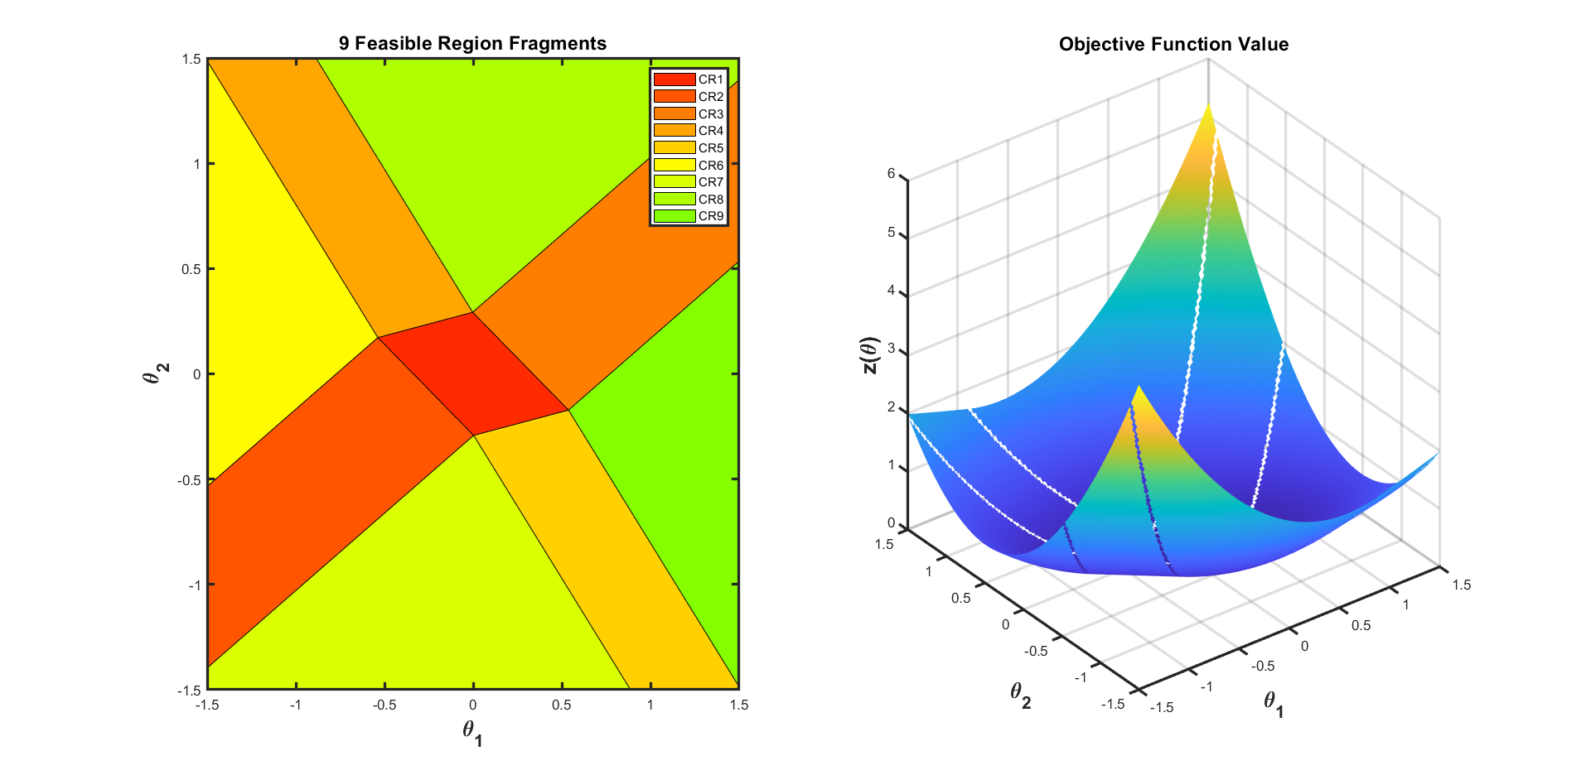
Multiparametric Programming
Formulation of Multiparametric Linear (mp-LP) and Quadratic Programming (mp-QP)
Solution of mp-QP: 𝒙(𝜃)^{𝘪}=𝑊^{𝘪}𝜃 + 𝘸 CR^{𝘪}: Φ^{𝘪}𝜃≤𝜙^{𝘪}
The parameter space(𝜃 ) is partitioned into nine set of critical regions (CR_{i}).
Each critical region has its own function optimal solution x*(𝜃 ) and Z*(𝜃 )
Verification was done using quadprog solver
Reference: Faísca NP, Dua V, Pistikopoulos EN. 2007 Feb 9;1:1-23.

Slide 13
Explicit MPC
Advantages
Solves the optimization problem offline for all the states within a range.
Solution is precomputed for each state within a range.
u(x)
x

Slide 14
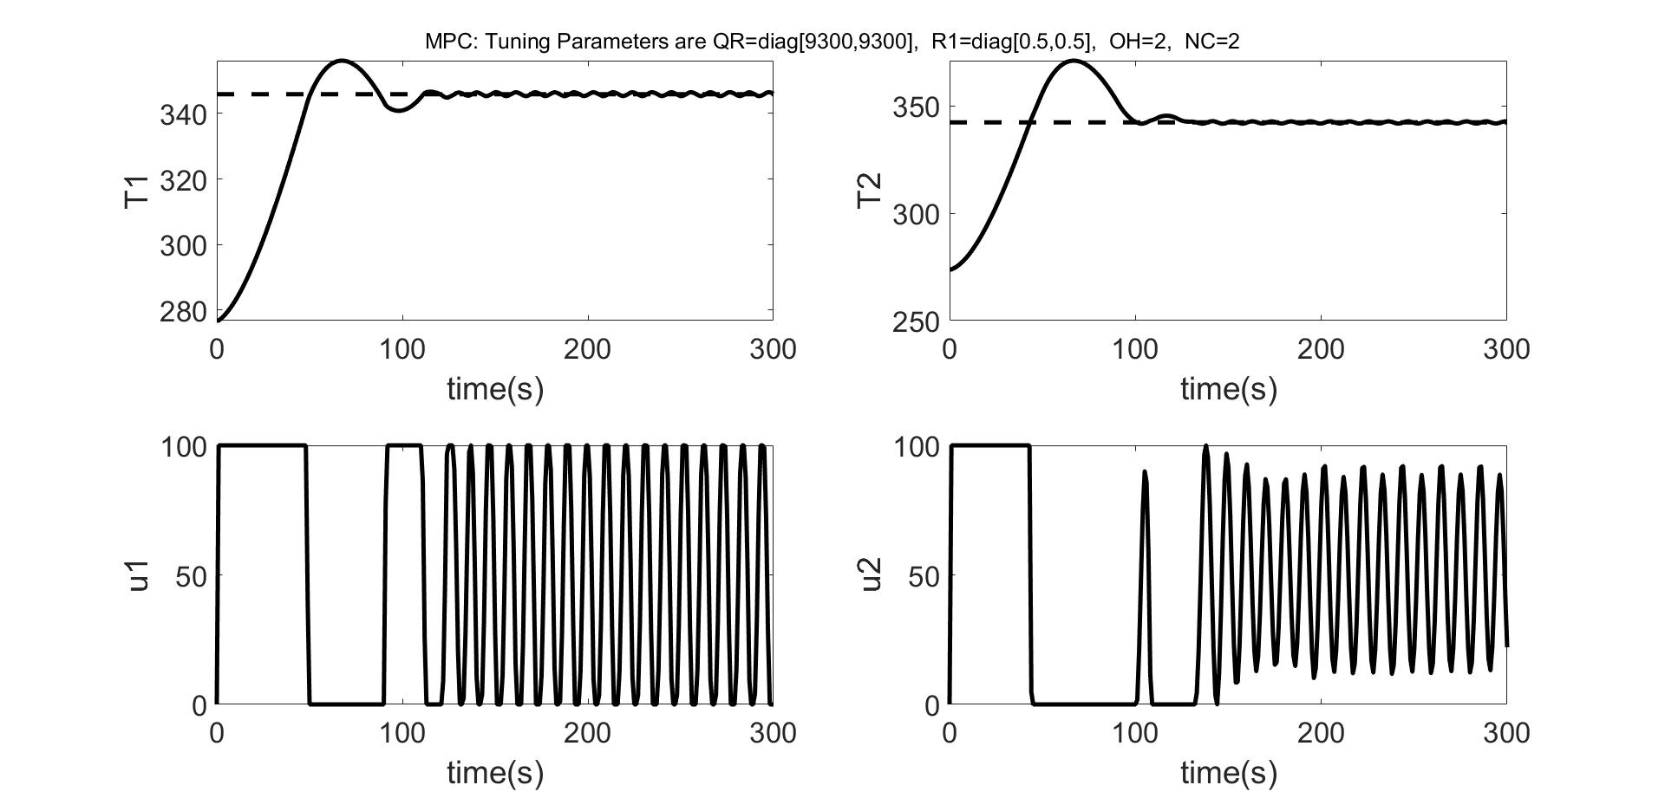

Closed Loop Simulation Results
Online MPC
mp-MPC
Online MPC and mp-MPC results match.

Slide 15
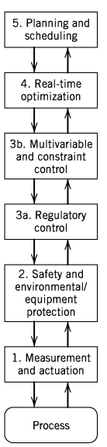
Hierarchical order in process industry
Background
Process control activities are organized in the form of hierarchy as shown in Figure 1.
For profitable plant operation the process control activities at different levels should be carefully coordinated.
Multi-level decision structures can be mathematically represented using multi-level programming principles.
Model predictive control (MPC) strategy.
Standard feedback and feedforward control techniques.
To measure process variables and implement the calculated control actions.
Figure 1: Hierarchy of process control activities
Reference: Seborg DE, Edgar TF, Mellichamp DA, Doyle III FJ.2016 Sep 13.

Slide 16
Bilevel Programming Problem (BLPP)
Motivation
In some literature, researchers have addressed bilevel decision-making problems.
Ryu et.al have taken one level as plant planning/control problem and other level as as distribution network problem.
Styliani et.al have recasted planning and scheduling integration as a bi-level multi-follower problem. Upper level (planning) and lower level (scheduling).
Bilevel programming have evolved significantly in recent years.
Tri-level and other general multi-level programming problems
too are evolving gradually.
Reference: Ryu JH, Dua V, Pistikopoulos EN. 2004 Jun 15;28(6-7):1121-9.
Reference: Avraamidou, S., & Pistikopoulos, E. N. (2018, June). IEEE.

Slide 17

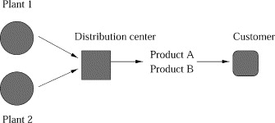





Bilevel Programming Problem (BLPP)
Bilevel Optimization Model
Leader’s problem or
High level decision problem
Follower’s problem or
Low level decision problem
Aim is to minimise both Production cost and distribution cost.
Process configuration of an enterprise
First level (production model) is constrained by another optimization problem (second level,the distribution model).
Reference: Ryu JH, Dua V, Pistikopoulos EN. 2004 Jun 15

Slide 18







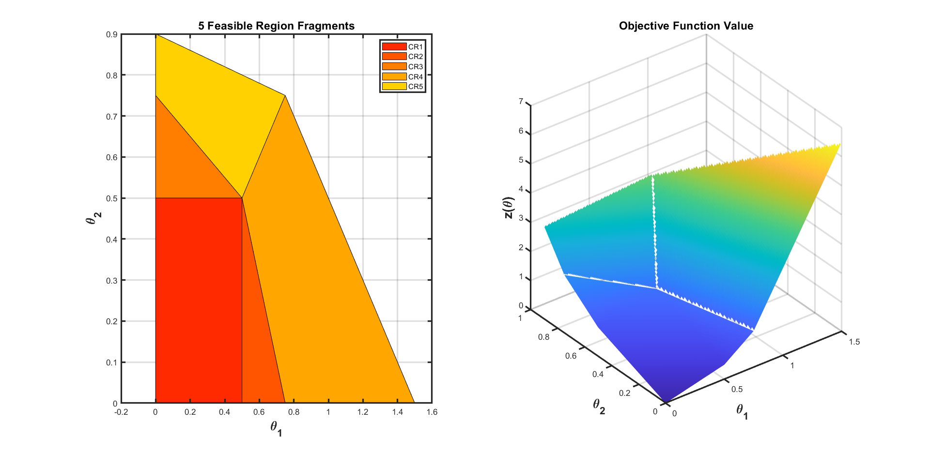
Bilevel Programming Problem (BLPP)
Formulation of Linear BLPP (LP/BLPP)
Five critical regions are obtained with y as an explicit function of x.
Inner Level solved multi-parametrically
Reference: Faísca, Nuno P., et al. Journal of Global Optimization 38.4 (2007).

Slide 19
Bilevel Programming Problem (BLPP)
Solution of a linear bilevel programming problem.
Fields | Optimised variables (𝑥) | Function values
1 | [0.5000 ; 0.5000] | -6
2 | [0.5000 ; 0.5000] | -6.0000
3 | [0 ; 0.7500] | -23.0000
4 | [0.5000 ; 0.5000] | -6.0000
5 | [0 ; 0.9000] | -26
Solution obtained after solving outer level problem
Global optimum solution

Slide 20
Bilevel Model predictive control
One of the application of Bilevel lies in hierarchical model Predictive control (MPC) structures.
In recent attempt has been made to solve MPC in hierarchical manner.
Styliani et.al in 2017 employed two level hierarchical mp-MPC on a continuous stirred tank reactor (CSTR) system.
Use of a multi-parametric bi-level algorithm for the development of explicit hierarchical controllers has limited application.
So such algorithms hold a good possibility to be explored and extended on more complex systems in near future.
Controller 1 (Optimisation Problem 1)
Controller 2 (Optimisation Problem 2)
System
Avraamidou S, Pistikopoulos EN.In Computer aided chemical engineering 2017 Jan 1.Elsevier.

Slide 21
Bilevel Model predictive control
Case Study

Slide 22
Conclusions and Future Work

Slide 23
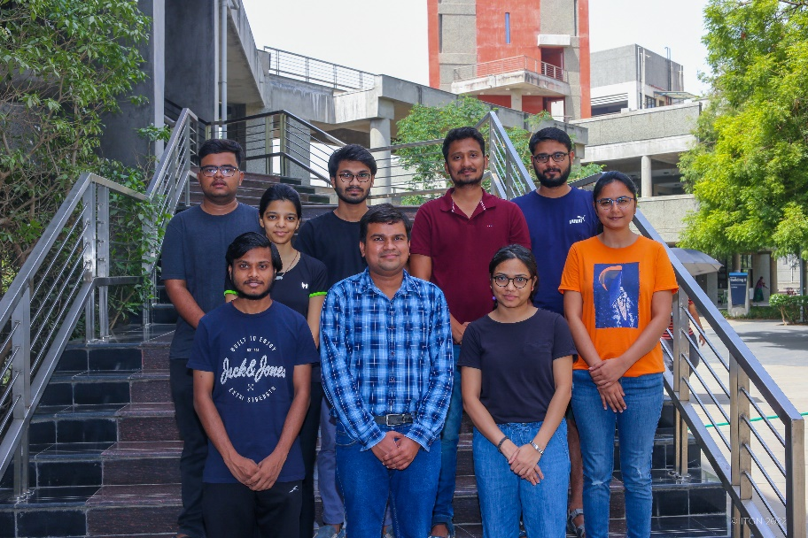
Acknowledgement
I am thankful to the Post-doc in our research group Dr. Radhe Saini for his guidance during my course project.
I am also thankful to Prof. Hari Ganesh research group
members for their support.
Thank You!

